Slide 1
GAURAV SHARMA
Data & Analytics
August 1, 2024

Slide 2
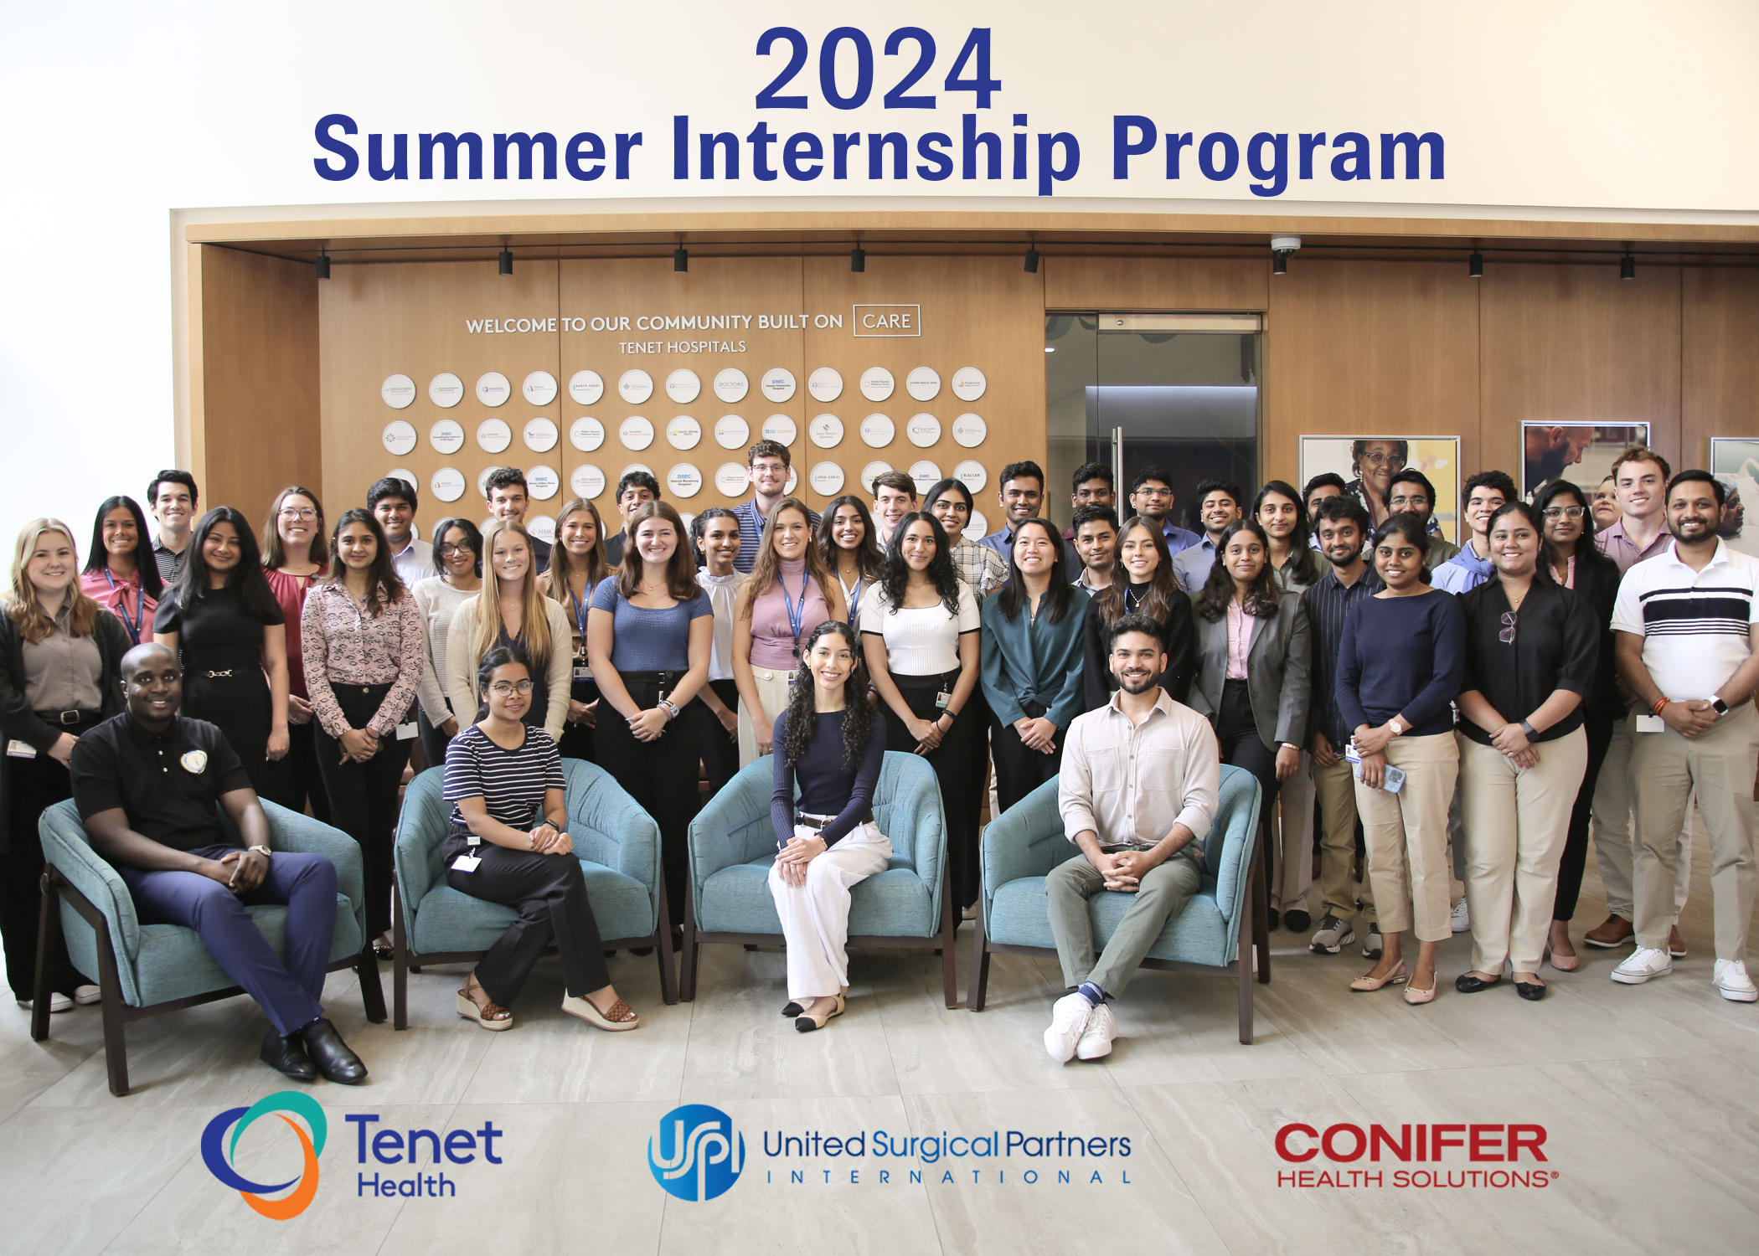
About Me
University of Texas Dallas : MS CS
From Dallas
Department/team/team leader name:
Suhail Hirani
Sama Srikanth
2

Slide 3
About your Experience
During my internship at Tenet Healthcare, I have worked on some critical projects, and I learned how to design a configuration-driven data ingestion framework and gained hands-on experience with ETL processes and tools like BigQuery and Airflow.
I was surprised by the complexity of data validation and how minor discrepancies can significantly impact clinical data accuracy.
An opportunity for improvement is enhancing automation in the data validation process to quickly identify and resolve discrepancies between development and production environments.
3

Slide 4
Ingestion 2.0 Clinical IDM
Ingesting data from sources(hospitals) to Server(BQ) using Ingestion framework 2.0

Slide 5
Project Overview
Ingestion 2.0 and Clinical IDM
Implementation of Ingestion Framework 2.0 and Clinical IDM failure resolution
Problem: The existing data ingestion process lacked scalability, making it difficult to efficiently handle multiple tables and various data sources.
Goals:
Develop a configuration-driven ingestion framework 2.0.
Implement additional functionality like restartability etc.
Problem: Address data inconsistencies between development and production environments in the Clinical IDM project
Goals:
Identify and resolve data mismatches to ensure consistency and integrity of clinical data.
5

Slide 6
Project Cont.
What I Did
Designed and developed the Ingestion Framework 2.0, creating a configuration-driven, automated data ingestion process.
Who Else Was Involved
Collaborated with senior data engineers, database administrators, and project managers to ensure the successful implementation and integration of the projects.
Skills Needed for Success
Proficiency in Python, SQL and BigQuery for data handling and manipulation.
Experience with Apache Airflow for workflow orchestration.
Effective communication and collaboration skills to work with cross-functional teams.
6

Slide 7
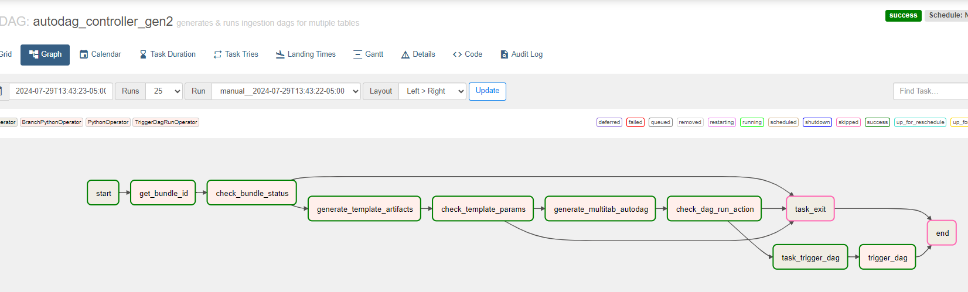
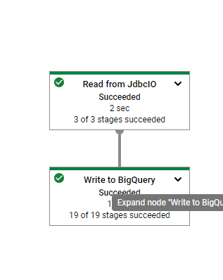
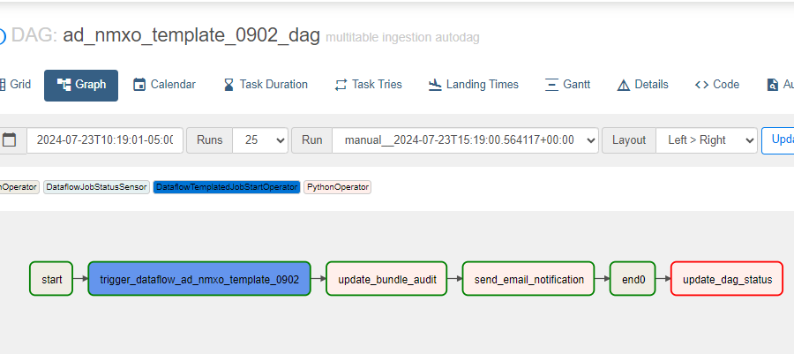
Financials/measurables
Reducing the cost for triggering the dataflow jobs for every table and introducing the restartability.
7

Slide 8
Impact
Ingestion Framework 2.0:
Previously, Ingestion Framework 1.0 triggered a separate Dataflow job for each table, resulting in higher operational costs.
Ingestion Framework 2.0 allows multiple tables to be ingested within a single Dataflow job. This improvement reduces the number of Dataflow jobs triggered, significantly cutting costs and optimizing resource usage.
Also added the support for other source system like AS400 previously it was only supporting the SQL server.
Clinical IDM Data Reconciliation: In the production environment, the Clinical IDM data was static, leading to discrepancies when compared to the dynamic data in the development environment. By aligning the data handling processes between DEV and PROD, the project enhanced data consistency and reliability, supporting accurate clinical decision-making and operational efficiency.
8

Slide 9
Takeaways
How This Internship Helped Achieve My Goals and Expand Skills
This internship provided practical experience in designing and implementing complex data ingestion frameworks, which directly aligned with my goal of becoming proficient in data engineering
Advice for Future Interns
Be Proactive
Seek Feedback
Document Your Work
Collaborate Effectively
Embrace Challenges
9

Slide 10
Acknowledgements
I would like to extend my heartfelt gratitude to:
Srikanth Sama: For your guidance, support, and valuable feedback throughout my internship. Your mentorship has been instrumental in my growth.
The Data Engineering Team: For welcoming me into the team and providing a collaborative environment where I could learn and contribute effectively.
Everyone at Tenet Healthcare: For your support, insights, and encouragement that made this internship a rewarding and enriching experience.
Thank you all for making my summer internship an incredible learning journey!
10

Slide 11

Questions?

Slide 12


